Slide 1
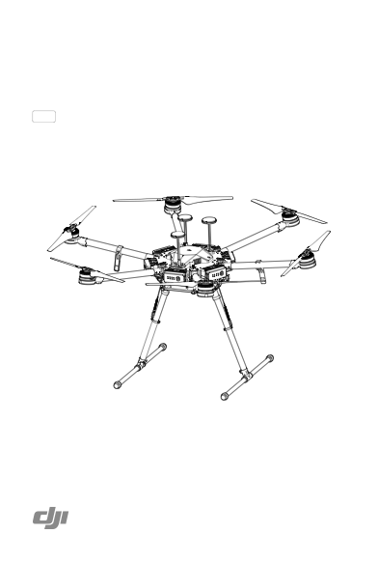
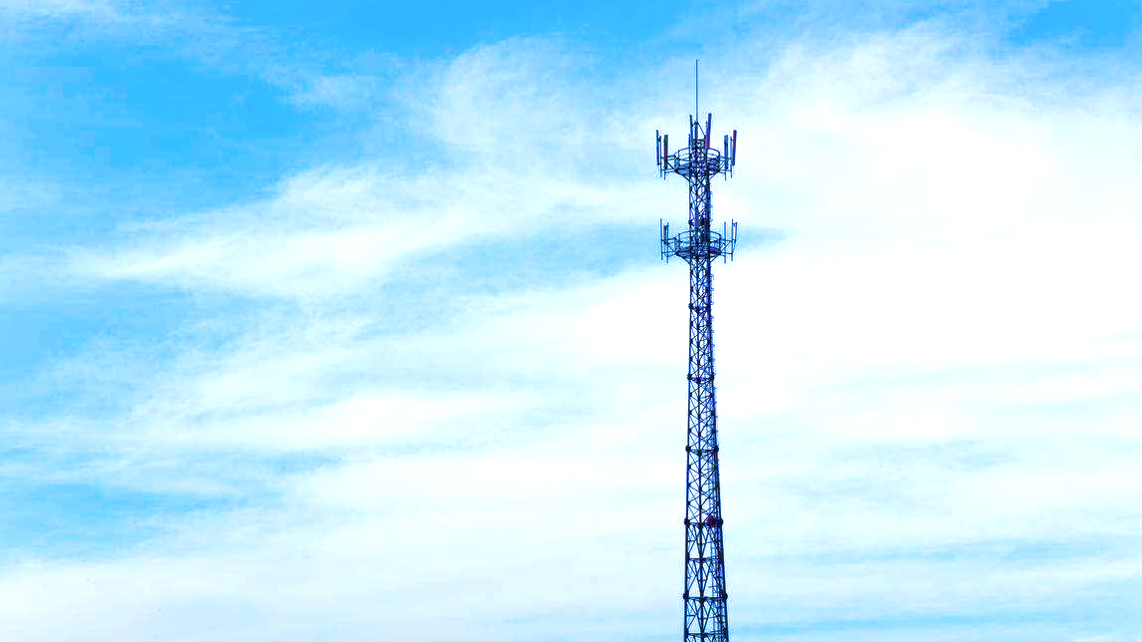
Integrated Ground-Air Test System
Solution for FDD Interference Detection

Slide 2
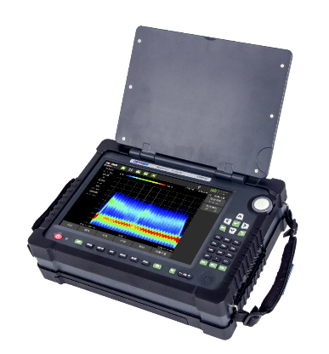
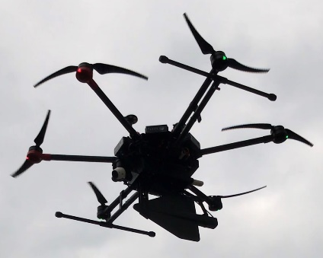
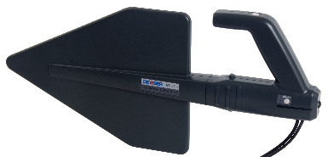
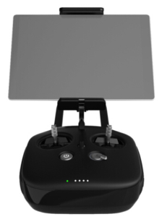
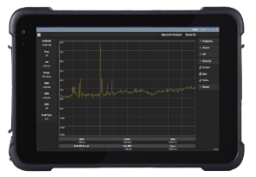
1 Overview: Integrated ground-to-air test system
▷ One-drone Version
▷ Two-drone Version
(Collaborative Detection)
▷ Correlative Interferometer DF
Antenna Version
Six rotor industrial drone
Wireless Spectrum Test Receiver
Omnidirectional, directional,
interferometer antenna
Cloud Data Server
Cloud Control Server
Public or Private Server
Mobile Ground Terminal
Flight control terminal
Handheld Directional Antenna

Slide 3
3 Benefits of the solution
Traditional detection method
Integrated ground-to-air detection method
Climbing buildings Prohibited / Dangerous
Local help is required The main interference signal cannot be detected.
Entering the building due to access guarding / not possible.
Manual detection with portable devices takes a long time.
Roof Test
Rarely necessary
Tower BS
Lifting the drone blocks the direction of the main radio signal.
Interference at high buildings
Drone lifts off for fast measurement
Multiple sources of interference
Drone lifts off for fast measurement
Ground-to-air integrated detection method: The efficiency is 5~10 times higher than with the traditional method. The most difficult impurities can be found, which cannot be found with the traditional method.

Slide 4
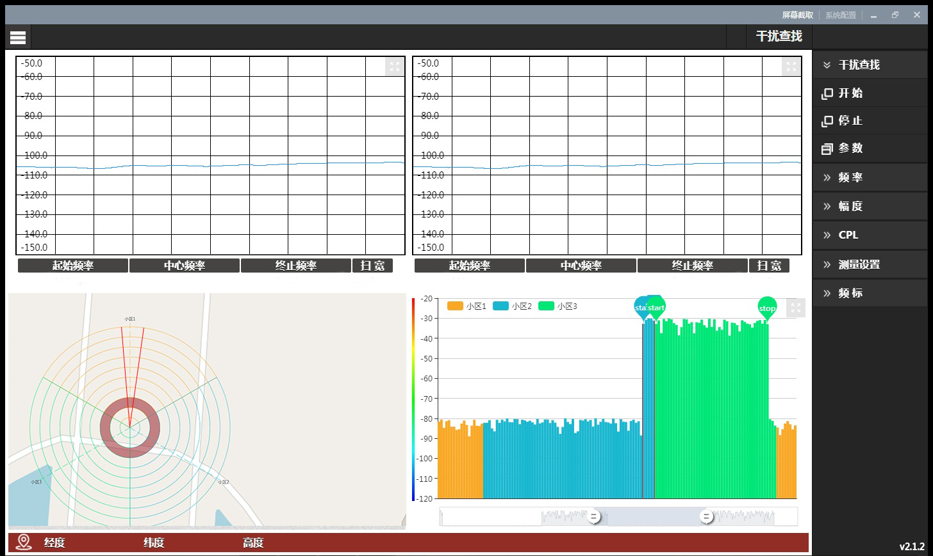
2 functions - fault location
Drone
Ground
Five-step interference detection method
① The operator makes disturbed spectrum and disturbed cell of the background available.
② The drone scans the sky to check the sector field in the direction of interference.
③ The drone flight along the normal direction of the sector area, searching for the position of the maximum signal point.
④ Combine drone vertical maneuvers with ground equipment to perform locating and detection.
⑤ Remove the source of interference and confirm it in the background.

Slide 5
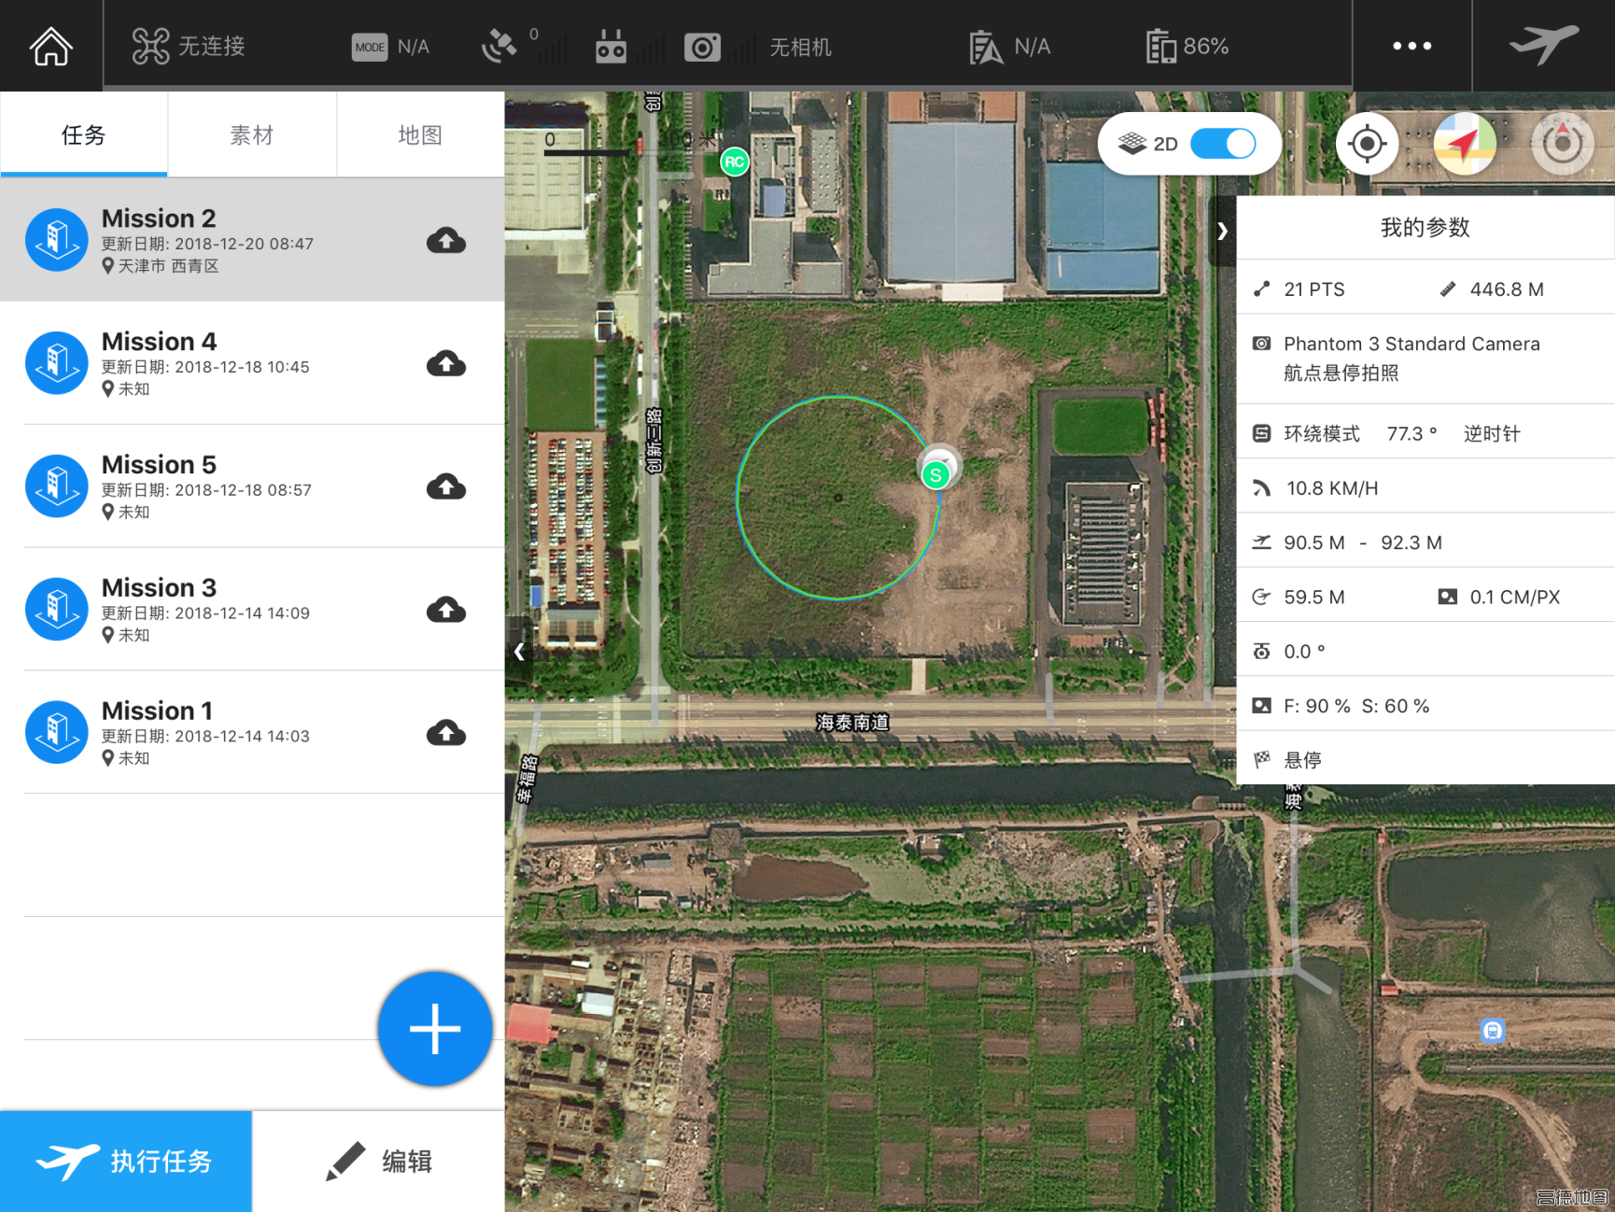
2 functions flight planning, programming
Flight planning and automatic flight● 2D/Display of satellite map
● User-defined altitude, speed
● Radius
● The flight mission is stored in the cloud
● Flexible processing of multiple tasks
● Take-off and landing at the touch of a button
● Automatic flight follows mission, project path

Slide 6
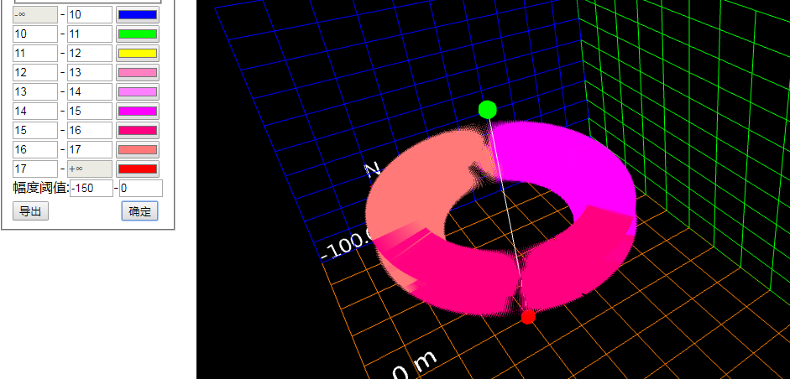
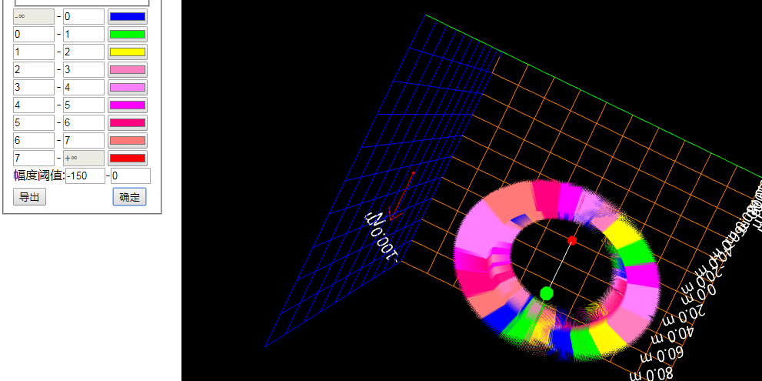
2 Funktions- 3D Coverage Test
3D Coverage Test -Cell ID, Beam ID
① The ground module controls the flight module
and edit the 5G data.
② The flight module collects and analyzes
the 5G data, demodulates the
Cell ID and Beam ID and sends them to the
to the cloud.
③ The cloud forwards the data to the
Floor module for summary.
④ The 3D map of Cell ID and
Beam ID is determined by the data analysis
in the floor module.
Cell ID
3D coveragestest
Beam ID
3D coveragetest

Slide 7
3 Solution Configurations
Drone Platform（Customizable）
Size | 1668mm*1518mm*727mm（arm, propeller, bracket unfolded, with landing gear）
Weight | 9.5kg
Recommended maximum load capacity | 6kg
Hover accuracy | Vertical: ±0.5 m, Horizontal: ±1.5 m
Maximum bearable wind speed | 8m/s
Hover time | 30min
High Performance Spectrum Module
Frequency measuring range | 9kHz-9GHz
Maximum safe input level | ±25dBm（peak power/ entrance attenuation>15dB）; 50VDC
Sweep speed | 30GHz/s @7.8kHz
Real-time spectrum analysis bandwidth | Maximum 100MHz
Demodulation analysis support mode | 5G-NR， TDD-LTE， FDD-LTE
HD Camera
Controllable range of rotation | Pitch: -90° to +30°; Level: ±320°
Effective pixel of camera | 12.4 million pixels
Maximum resolution | 4000*3000
ISO range | 100-3200（Video）, 100-1600（Photo）
Electronic shutter speed | 8s-1/8000s
Lens optical parameters | 20mm（35mm format equivalent）f/2.8 infinity for focus
Directional Antenna
Model | ET20M/ET250M/ET500M/ET8000M
Frequency range | 9kHz-20MHz/20MHz-250MHz/200MHz-500MHz/500MHz-8000MHz
VSWR | <2.5
Hand shank | Low noise preamplifier + built-in high precision GPS + 3D electronic compass
Gain | Typical: 16dB（9KHz - 8GHz）
Noise figure | 2.4dB（typical）
E8900A, M 5G Portable Spectrum Analyzer
Model | E8900A
Frequency range | 9kHz-9GHz
Maximum safe input level | ±25dBm（peak power/ entrance attenuation>15dB）; 50VDC
Mean noise display level (normalized 1 Hz） | Amplifier Off：≤-140dBm 2MHz～1GHz, ≤-140dBm 1GHz～3GHz, ≤-135dBm 3GHz～6GHz, ≤-130dBm 6GHz～9GHz；
 | Amplifier On：≤-159dBm 2MHz～1GHz, ≤-156dBm 1GHz～3GHz, ≤-150dBm 3GHz～6GHz, ≤-145dBm 6GHz～9GHz；
Spectrum sweep speed | 30GHz/s @7.8kHz
Real-time spectrum analysis bandwidth | Maximum 100MHz
Demodulation analysis support mode | 5G-NR， TDD-LTE， FDD-LTE
Size | 228mm*316mm*77mm
Weight | <4.5kg

Slide 8
Integrated ground-to-air test system
+
Drone
Incl. Antenna
E8900M Analyzer
LTE Data card
Cloud Server
Incl. Software
Terminal
Ground System
Unique Complete Solution for debugging 5G antennas on the market initiated by Huawei
Target customer:
System Manufactur Ericsson, Nokia, Huawei
All mobile network operators
Regulators, federal network agency
System price 75000€ (Air) + 25000€ (Ground)

Slide 9
Thanks

