Slide 1
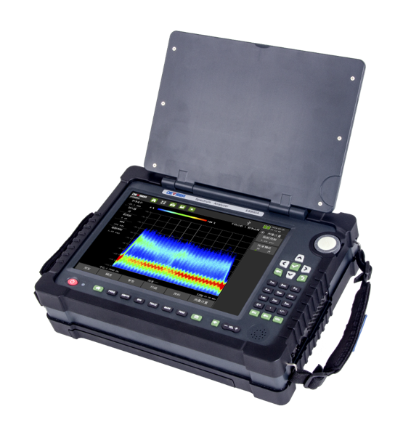

E8900A
5G Portable Spectrum Analyzer

Slide 2
5G NR (new Radio)
LTE (4G) the cell is not segmented 2, 3, 4, 8 MIMO Dataspeed 100 MHB
5G NR the cell is segmented in 8 beams Cell ID and Beam ID Massive 64 – 1024 MIMO 1 GB
5G NR approach SA pure 5G Solution or NSA 5G ontop of 4G LTE (common solution)
NSA for high Data and IOT
SA low latency + high Data and IOT
No RF connection at the antenna
All measuremets at the Air interface

Slide 3
1. E8900A Produkt Features
Frequency Range 9kHz bis 9GHz
30GHz/s Sweeptime (@7.8kHz RBW)
100MHz Real-Time Analyse Bandwidth
Downlink Signal Demodulation
Analyse of 5G NR Base Station
IQ Data Acquisition
integrated Antenna 300MHz – 8.5 GHz
Windows 10 OS
Portable Design

Slide 4
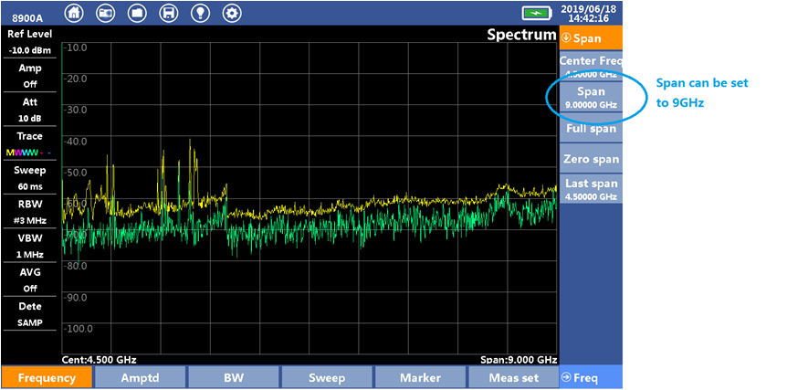
2. E8900A Funktions
Spektrum Analyser
● Frequency Range 9kHz bis 9GHz
● 20dB Preamplifier
● Tunable Attenuator von 0-50dB
● High sweep speed
RBW=7.875k 30GHz/s
RBW=15.75k 37GHz/s
RBW=31.5k 43GHz/s

Slide 5
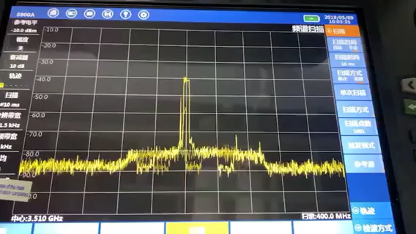
2. E8900A Funktions
Spektrum Analyse Funktion—5G NR Spektrum
The video shows the spectrum of a 5G NR signal of the air interface. The bandwidth in the 100MHz spectrum, the service channel is not completely occupied, the 100 MHz wide signal is very bursty.
The E8900A is the fastet Analyzer on the market

Slide 6
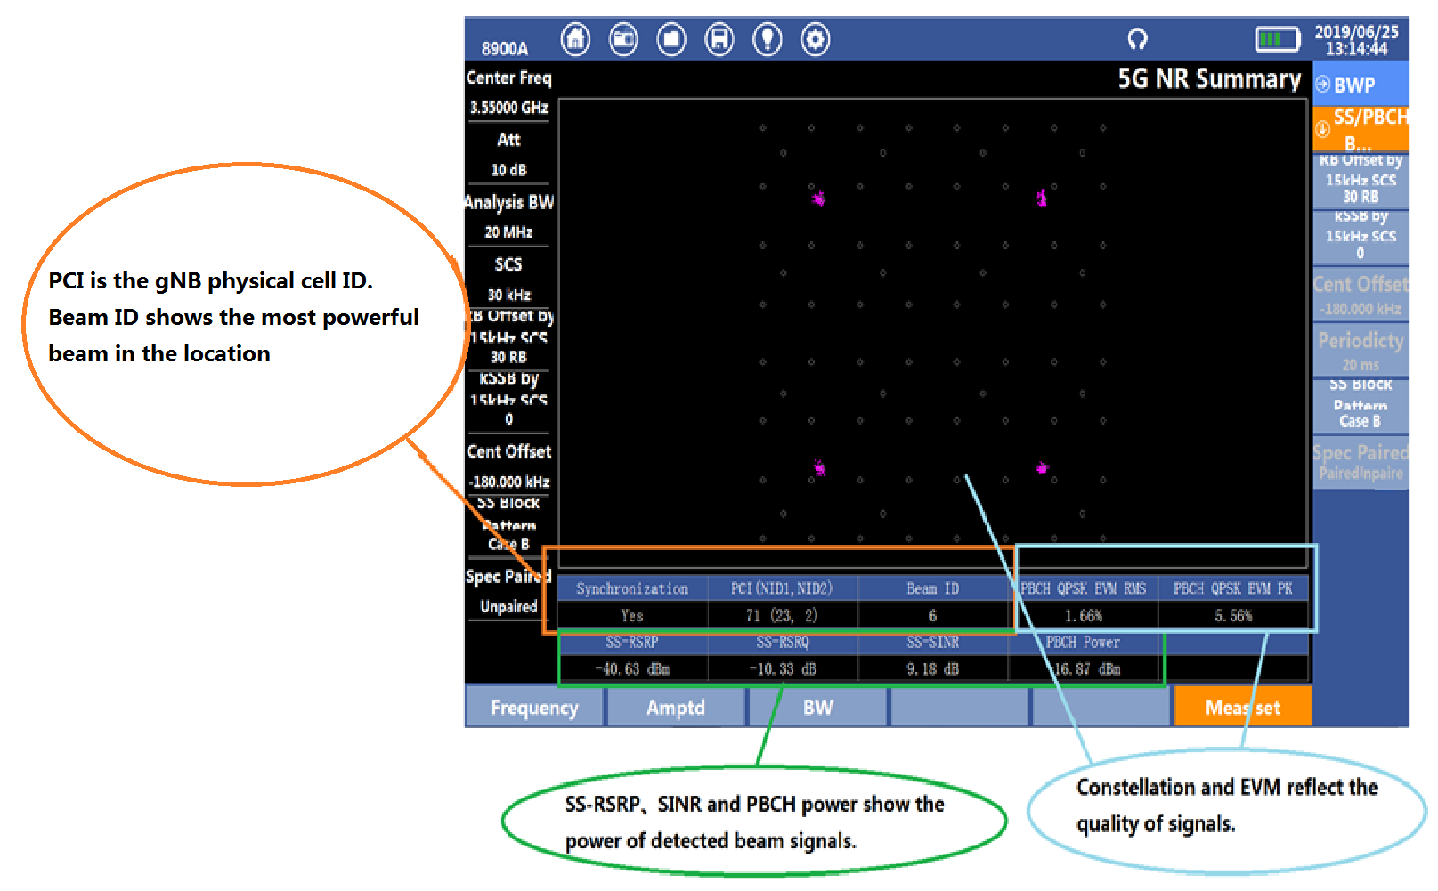
2. E8900A Funktions
5G NR Base Station Analyse Funktion
● Support 5G NR FR1 : Sub-6GHz
band measurement
● Support 5G NR base station downlink
signal measurement
● Supported measurements includes:
● Physical Cell ID(PCI)
● Beam ID
● PBCH Channel Constellation
● PBCH Channel EVM
● SS-RSR(reference signal received power)
● SS-RSRQ(Reference Signal Received Power)
● SS-SINR(signal-to-noise and interference ratio)
● PBCH Channel Power
SS Synchronization Signal
PB physical broadcast......

Slide 7
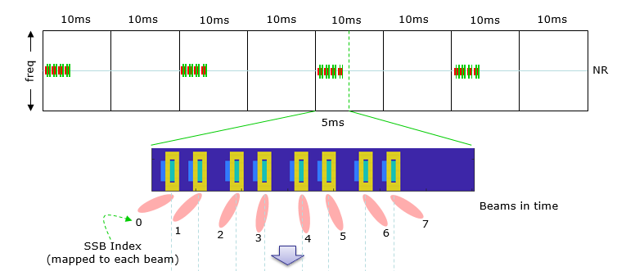
2. E8900A Funktionen
5G NR Base Station Analyse Funktion
The E8900A measures the physical Cell ID (PCI) of the Base Station and the Beam ID as well as the Power SS-RSRP (SS reference signal received power) of the current location.
SSB Synchronisation Signal Block

Slide 8
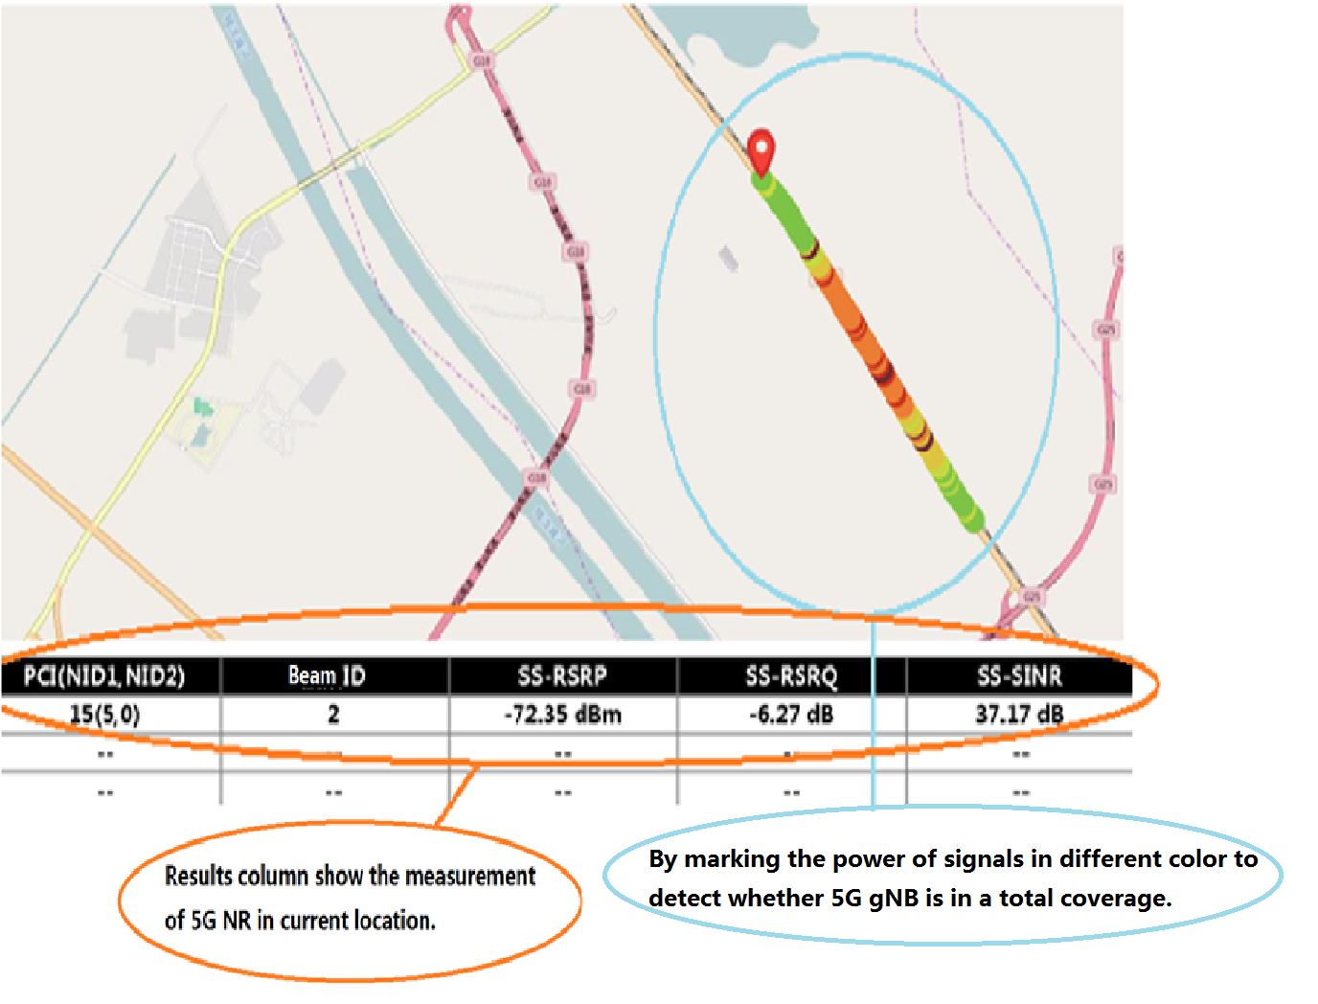
2. E8900A Funktions
5G NR Drive Test Function
The 5G NR Drive Test can test the signal intensity of the 5G base station,
The 5G Road Test is divided into Indoor Test and Outdoor Drive Test.
The parameters obtained at each test point such as PCI, Beam ID and SS-RSRP are automatically stored.

Slide 9
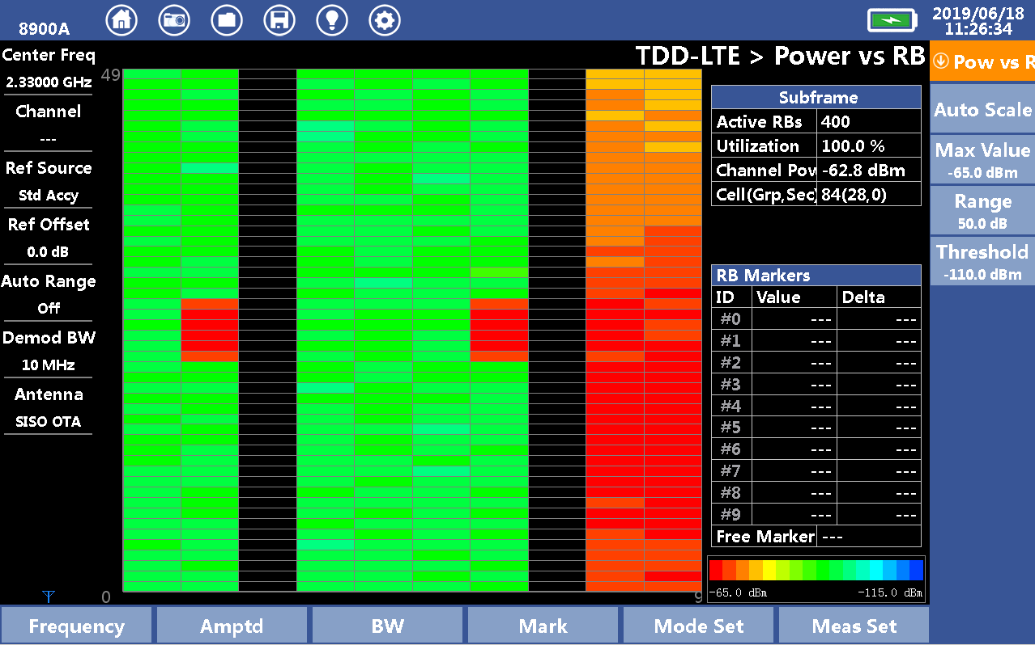
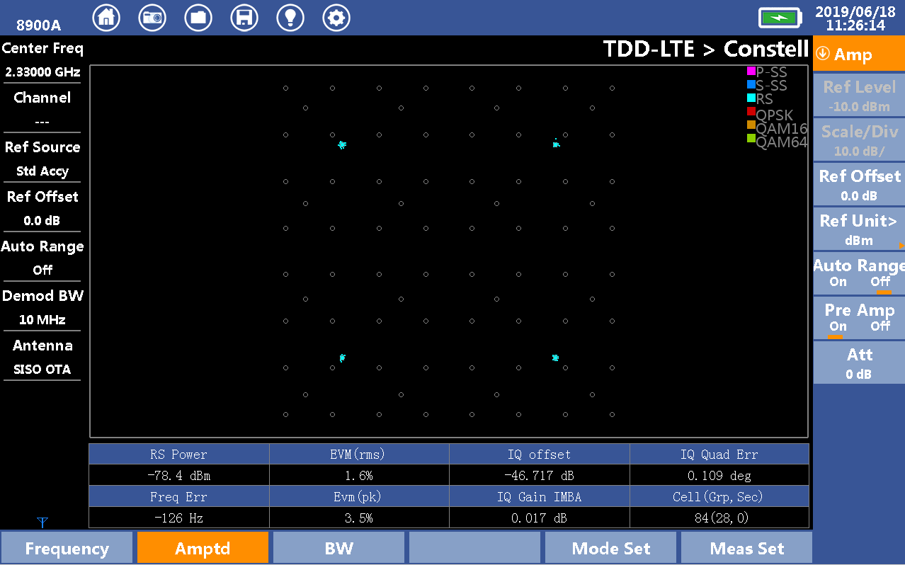
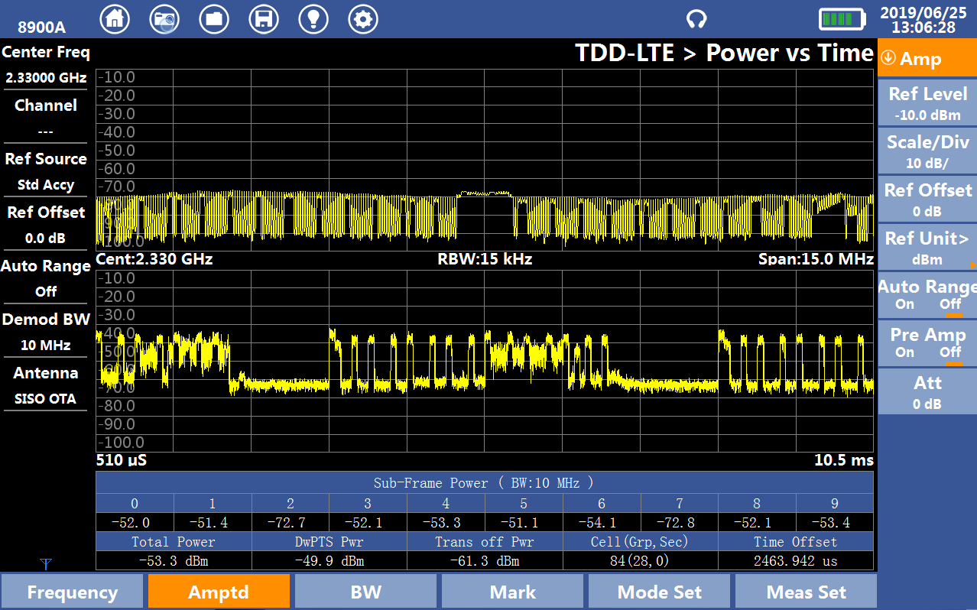
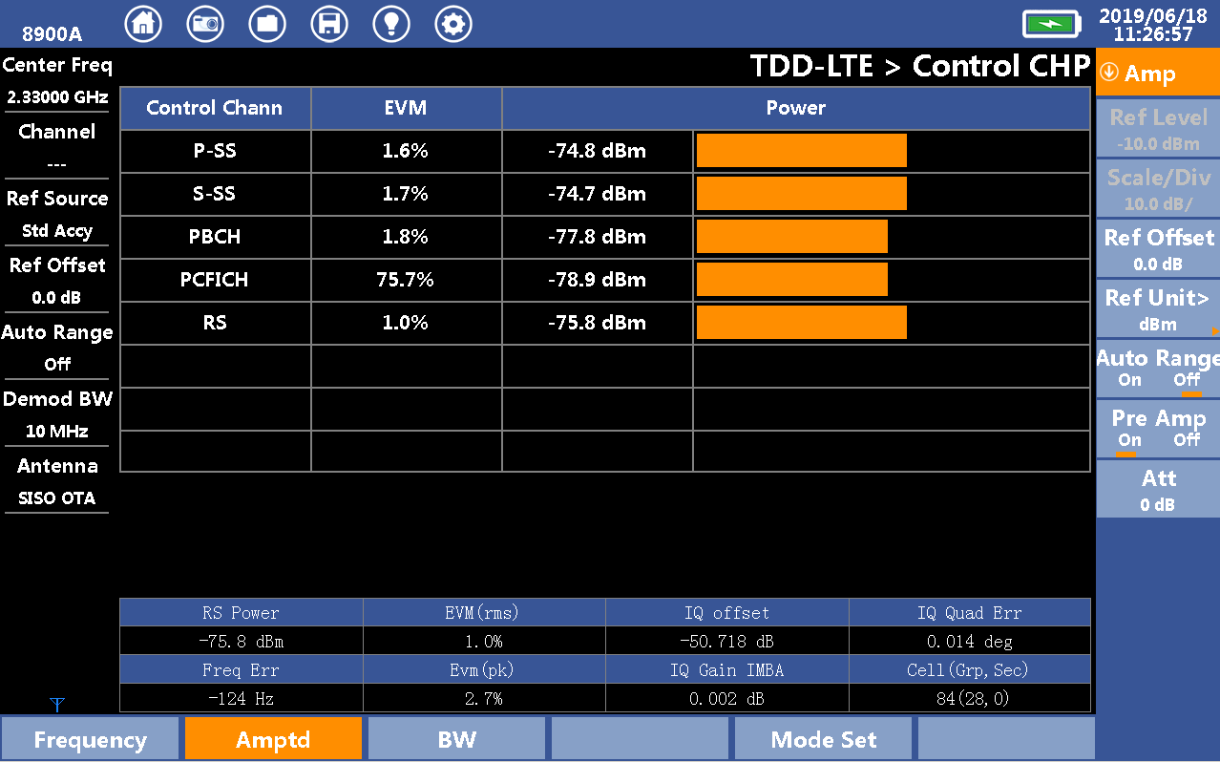
2. E8900A Functions
4G LTE Base Station Analysis Function
● RB Power
● Constellation
● Subframe Spectrum
● Channel Power
Similar in E 7042,62 8600

Slide 10
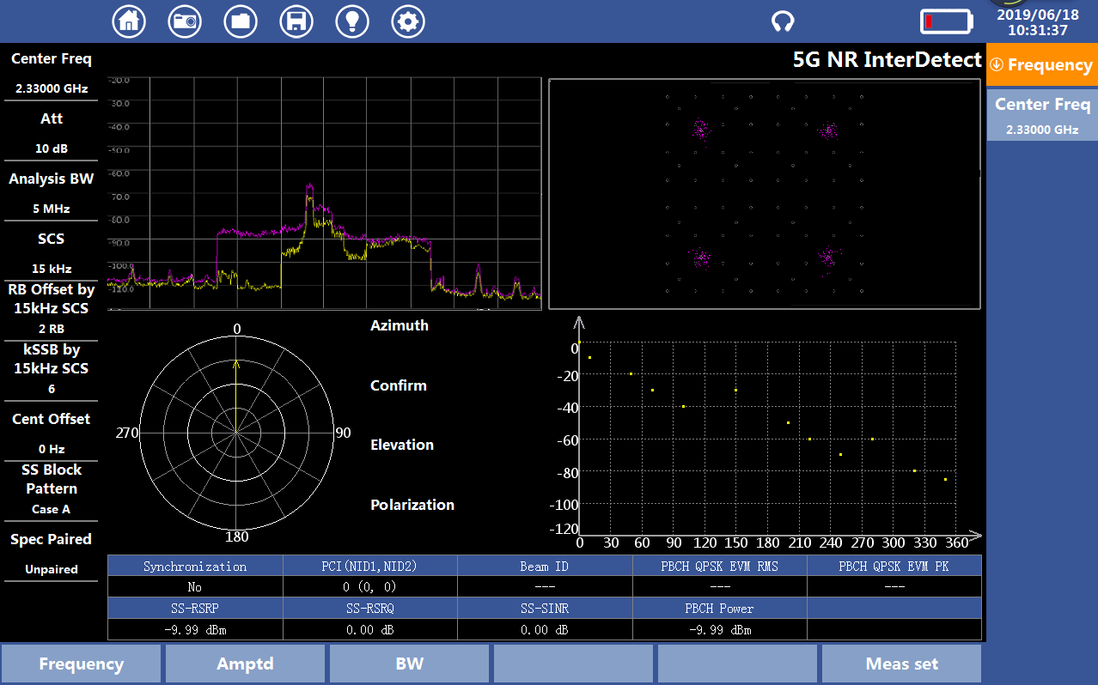
2. E8900A Functions
5G NR Interference Detection Function
● Support 5G NR Signal
localization
● 4 Screens are
displayed simultaneously
● Spectrum
● Constellation
● Antenna direction angle
● Power in all directions

Slide 11
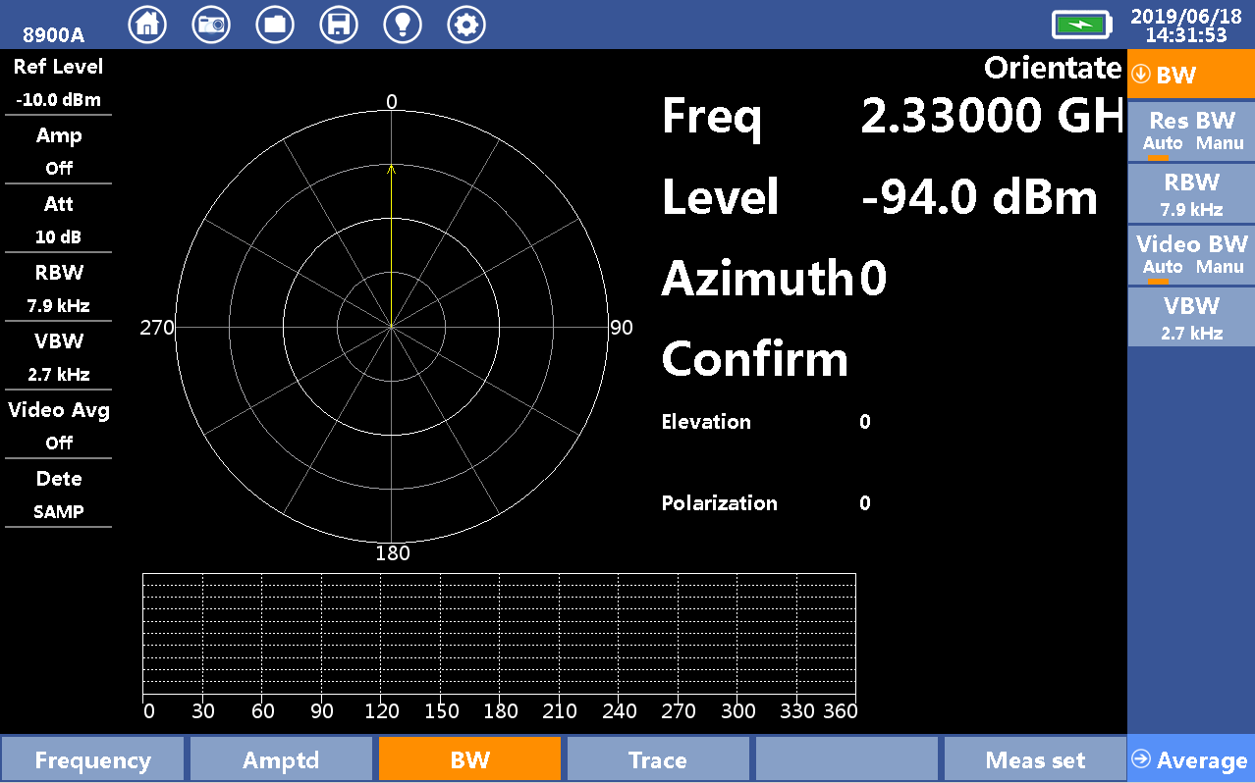
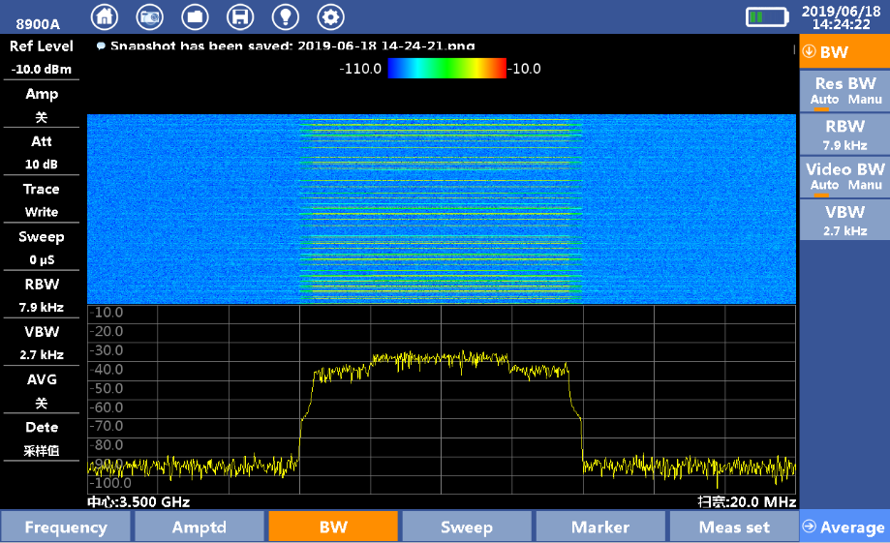
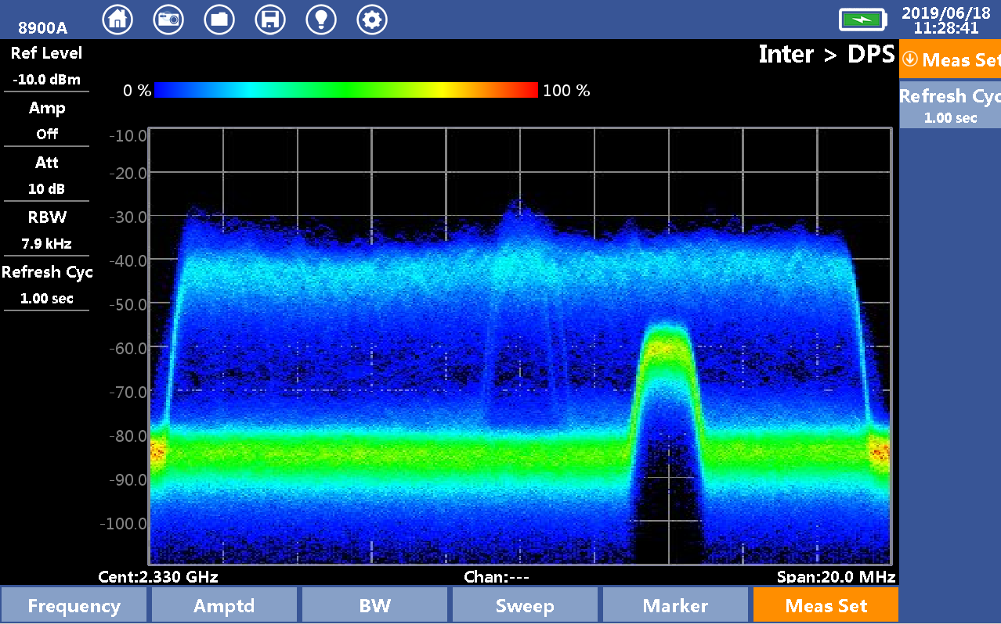
2. E8900A Funktions
Interference Analysis Funktions
● Spectrogram (Waterfall Display)
● DPX
● Interference Direction Finding
DPX

Slide 12
3. E8900A Roadmap
Software
Automatic Searching of SSB (August 19 free)
Interference Detection (August 19 free)
Displaying 8 Beamlist (August 19 free)
GPS Timing (September free)
Real Time Spektrum 100MHz (September 19 Option)
Downlink Analyzis (December 19 Option)
NB IoT (Dezember 19 Option depending Feedback)
LoRa (Dezember 19 Option depending Feedback)
eMTC (Dezember 19 Option depending Feedback)
Uplink Analysis (June 2020 Option)
eMBMS (March 2020 Option)

Slide 13
Thank you!

